Slide 1
Revit Import– PPVC
(IMPORT MODEL’S DATA FROM REVIT TO CREATE MODEL IN TEKLA FOR PPVC)

Slide 2
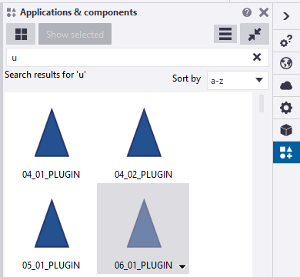
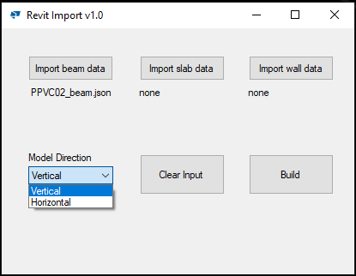
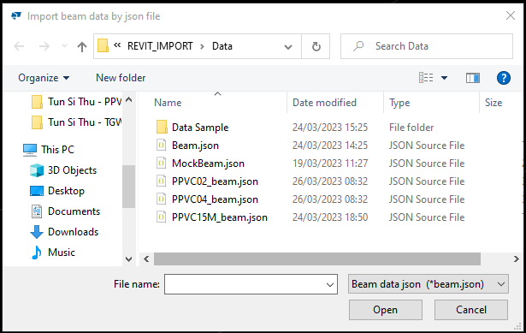
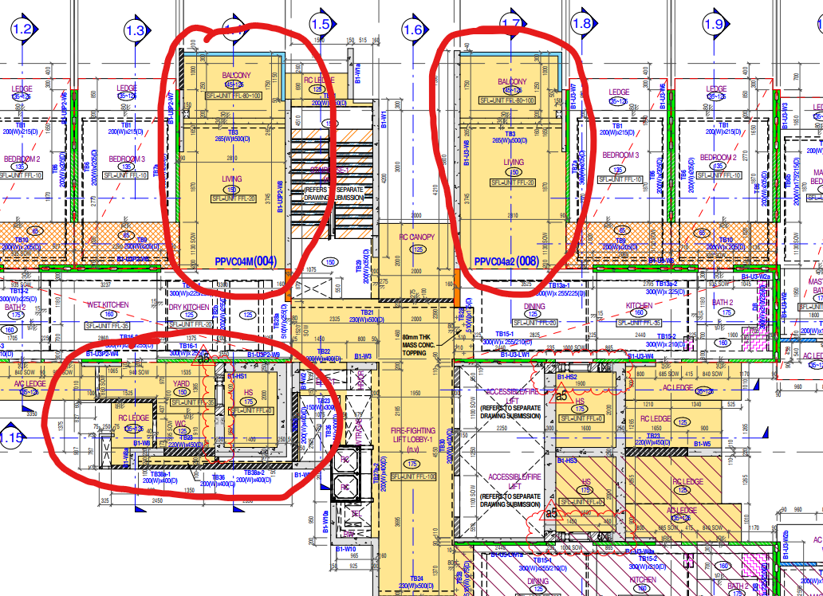
1) HOW TO USE THE PLUGIN
1
Go to “Applications & Components”
2
Search for “Revit Import”
4
4
4
Double click on “Revit Import”
5
3
4
Import data from json file
5
Display file that imported
6
8
7
6
Select model direction
7
Click “Build” and move the model to the correct location after finishing build
8
Clear Input if need to import another model
Vertical
6
4
Horizontal
6
4

Slide 3
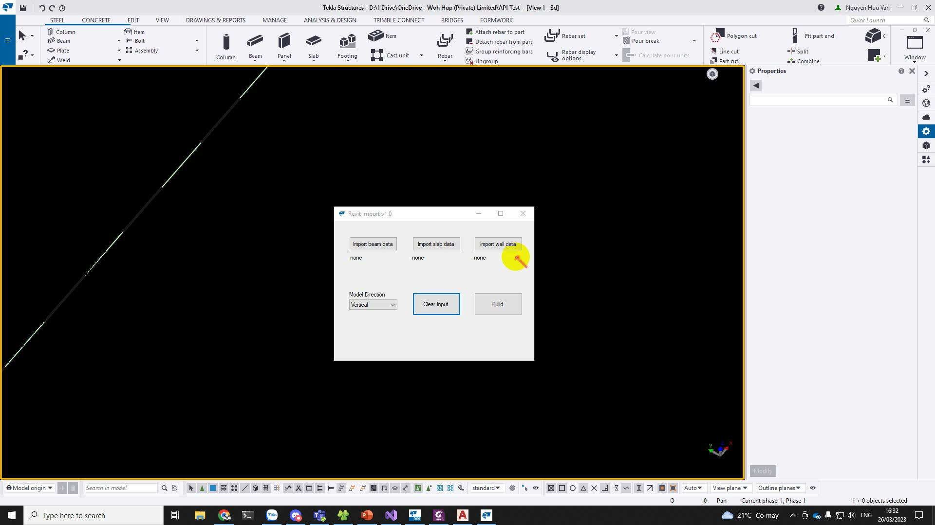
2) RESULT

Slide 4
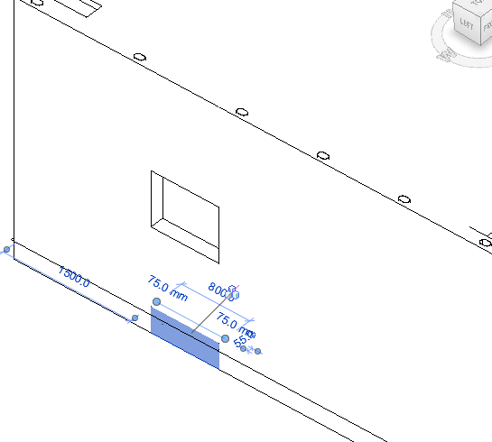
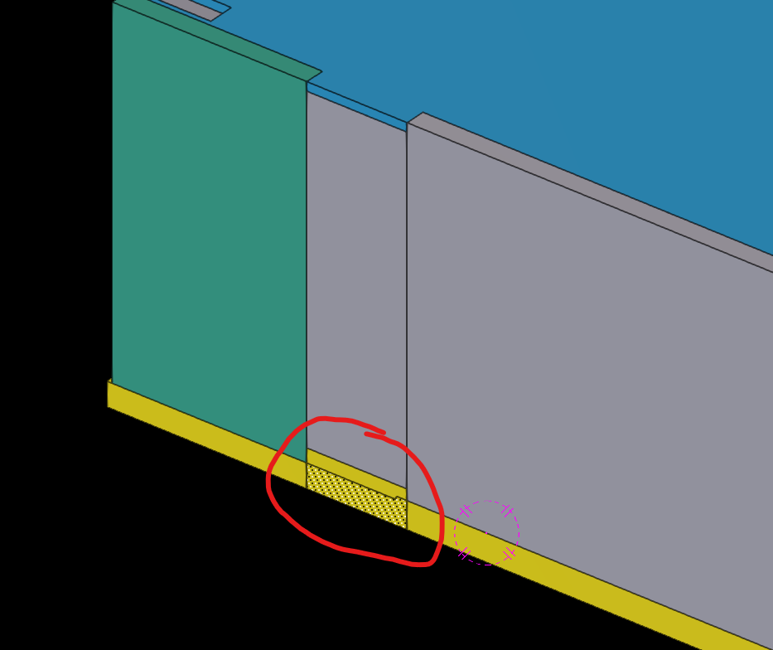
3) DRAWBACKS
ASF
What exists on the Revit model will also exist on Tekla model

Slide 5
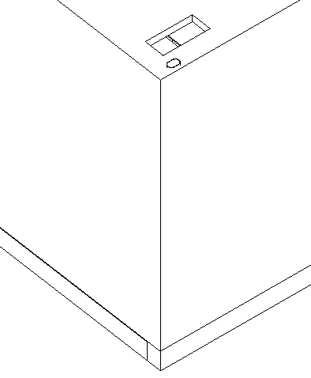
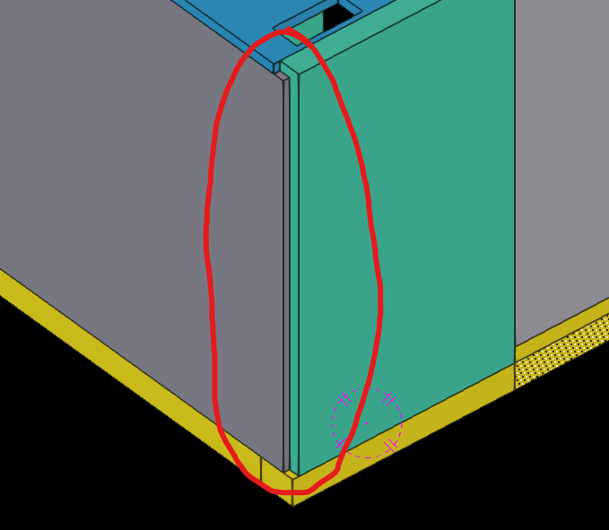
3) DRAWBACKS
ASF
The way model in Revit need to be same with Tekla

